Slide 1
Can AI Follow Clinical Guidelines?
A Study on Fluid Management in Sepsis
Team: Guardians of the Guideline
(Christopher Norberg, Ayush Gupta, Siranjeevi Balamurugan, Jiaxin Gao, Rajna Fani, Dukyong Yoon, Patt, VK, Mani Nagarathnam)

Slide 2
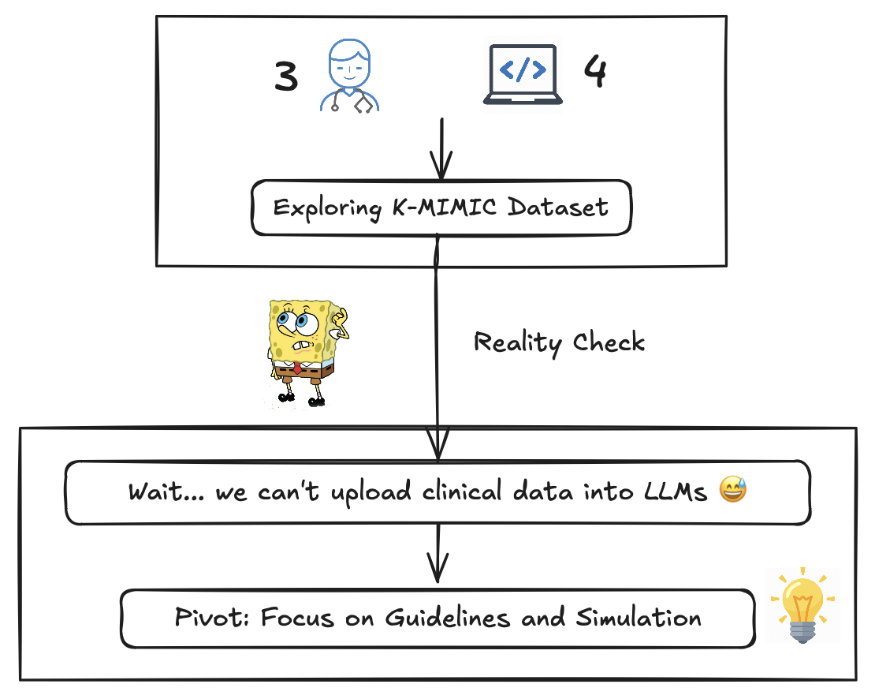

Slide 3
Understanding Clinical Guidelines and Sepsis
Clinical Guideline:
"A clinical guideline is a set of standardized recommendations created by medical experts to help healthcare providers make evidence-based decisions for patient care."
Sepsis:
"Sepsis is a life-threatening condition in which the body's response to an infection becomes dysregulated, causing widespread inflammation and organ failure."
Notes:
That is why we decided to focus on the clinical guideline to get a proper evaluation of the performance of an LLM. We were presented to the phenomenon of getting into a room with 5 clinicians and ne question and getting out of it with 8 different opinions. So what else could we rely on the best rather than the actual guidelines?

Slide 4
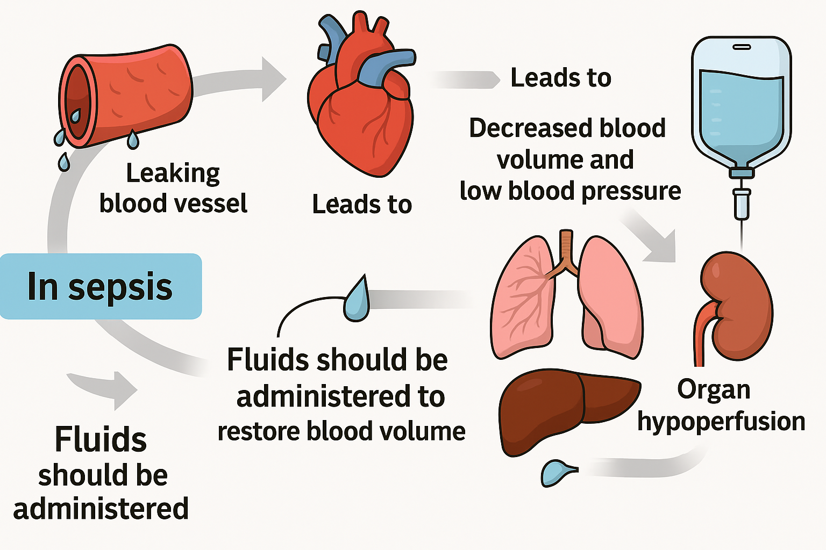
Notes:
We have to control fluid

Slide 5
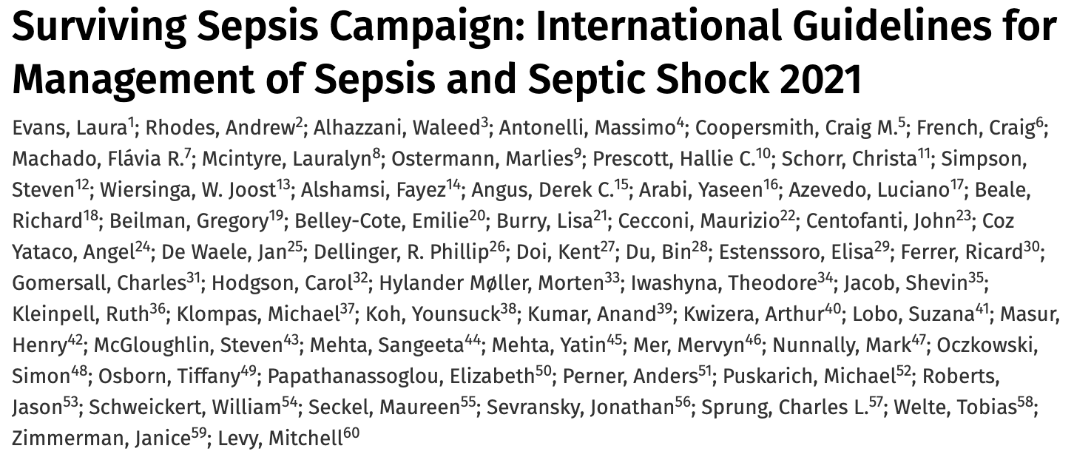
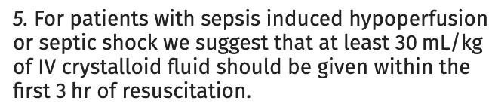
The Role of Fluids in Treating Sepsis
In sepsis, blood vessels become leaky and dilated, causing low blood pressure and poor blood flow to organs.
Rapid fluid administration is critical to restore blood pressure and maintain organ perfusion.
Notes:
The guidelines say that the optimal volume of fluid should be at least 30ml/kg. Based on that we built our research/ workflow

Slide 6
Testing AI Models Against Clinical Standards
Our Goal:
"We are testing whether a large language model (like GPT-4) can correctly recommend fluid amounts based on the 30 mL/kg guideline when given simulated sepsis cases."
Experiment Setup:
Generate simulated patient cases with varying body weights.
Prompt the AI with each case: "How much fluid should be given?"
Compare the AI’s answer to the clinical guideline.

Slide 7
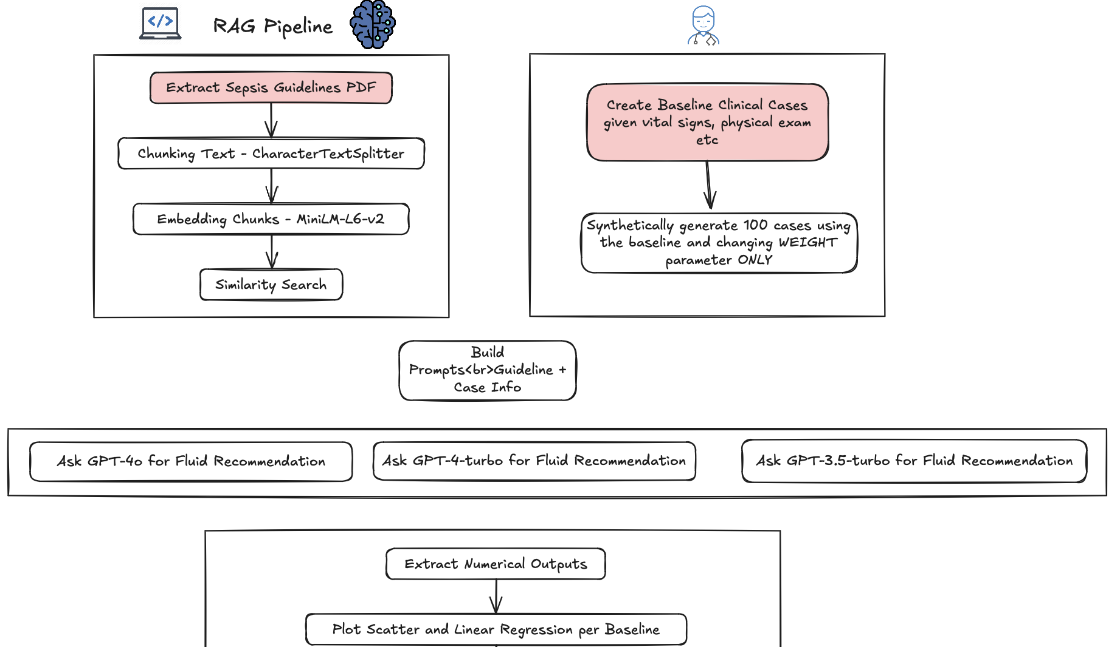

Slide 8
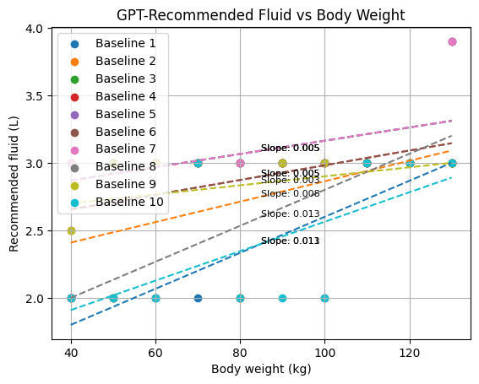
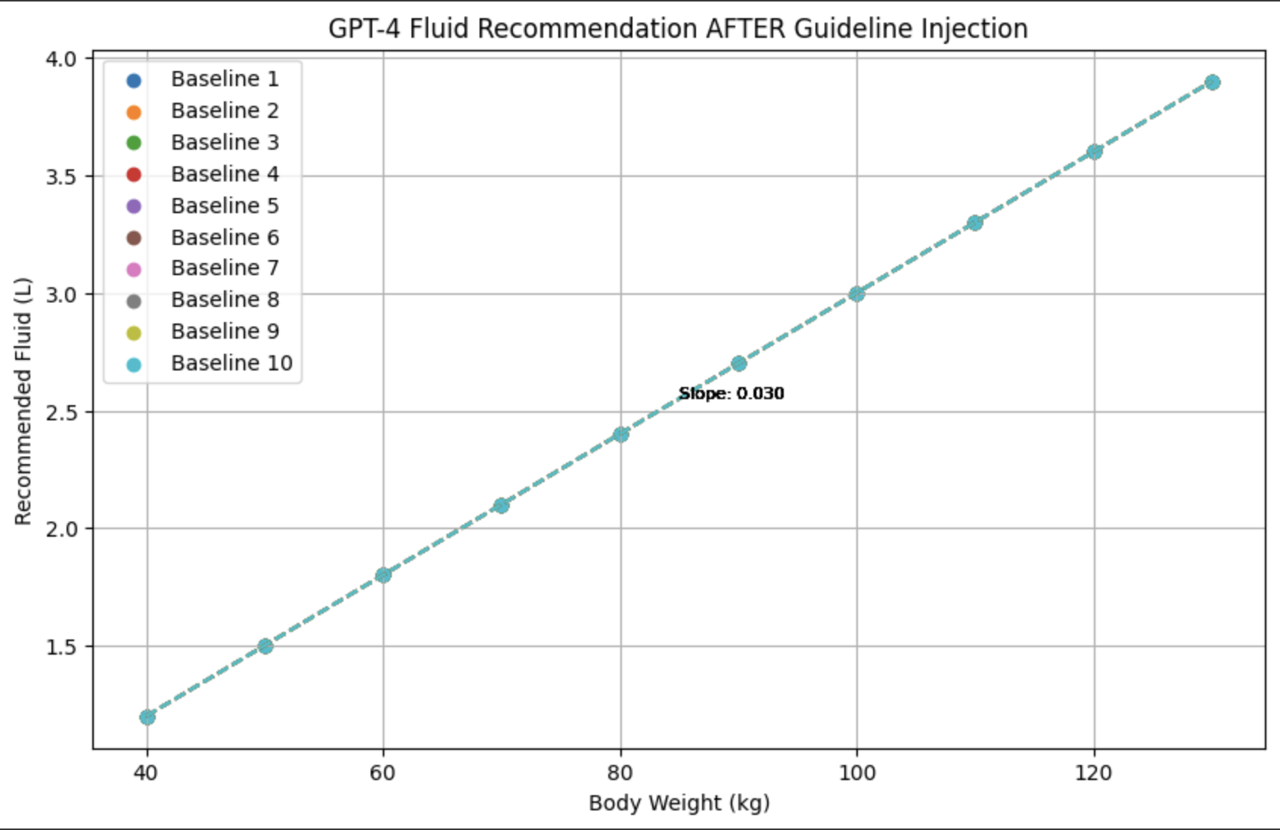
Results
GPT-4 turbo before RAG
GPT-4 turbo using RAG

Slide 9
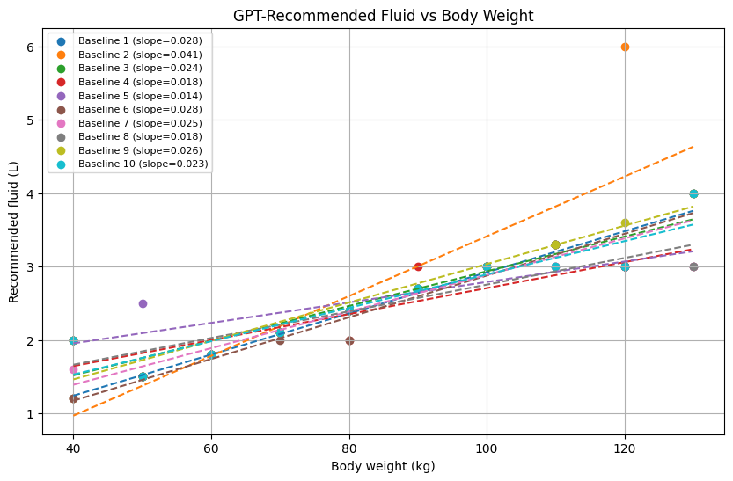

Results
GPT-4o before RAG
GPT-4o using RAG

Slide 10
Key Findings from the Fluid Management Study
As GPT models advanced from gpt-4-turbo to gpt-4o,
their ability to recommend fluid resuscitation according to clinical guidelines improved significantly.
However, even with the latest model (gpt-4o), performance was not perfect.
By integrating a Retrieval-Augmented Generation (RAG) approach —
where the model was provided with direct guideline references during prompting —we achieved perfect adherence across all cases.
Conclusion:
"While large language models show promising improvement, coupling them with retrieval systems is essential to ensure complete and reliable guideline compliance in clinical decision support."

